Slide 1
HR Employee Attrition Insights Dashboard
Power BI Project Presentation
Presented by: Sachin Saibo

Slide 2
Introduction
Brief about the project
Tools Used: Power BI, Excel, DAX
Objective: Understand and reduce employee attrition using data insights

Slide 3
Project Objective
Analyze employee attrition patterns
Identify key drivers behind employee exits
Recommend actionable strategies for HR teams

Slide 4
Key Metrics & KPIs
Total Attrition: 237 employees
Attrition Rate: 16%
Average Monthly Income: ₹6,500
Average Tenure: 7.01 years

Slide 5
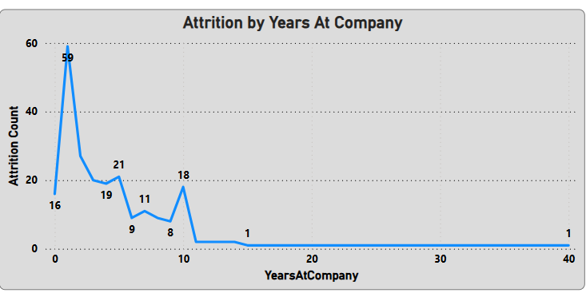
Attrition by Tenure
Highest in Year 1 (59 employees)
Over 70% occur in the first 3 years
Insight: Improve onboarding & early engagement

Slide 6
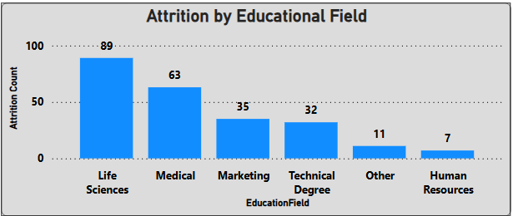
Attrition by Education Field
Life Sciences: 89 attritions
Medical: 63 attritions
Insight: Role misalignment or expectation mismatch

Slide 7
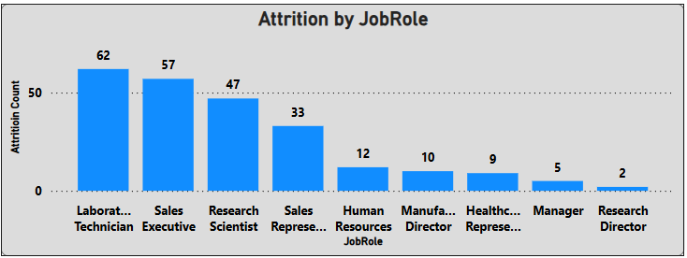
Attrition by Job Role
High in Laboratory Technicians, Sales Executives
Low in Managers and Directors
Insight: Address job satisfaction in mid-level roles

Slide 8
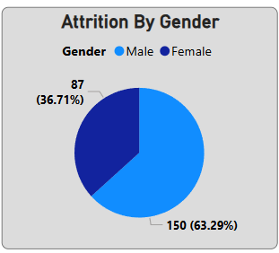
Attrition by Gender
Female: 37% of attrition
Male: 63%
Insight: Explore gender-specific challenges

Slide 9
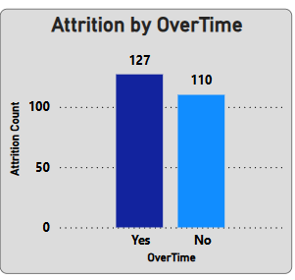
Attrition and Overtime
Overtime employees: 127 attritions
Non-overtime: 110
Insight: Monitor workload & prevent burnout

Slide 10
Business Recommendations
Improve onboarding experience
Review work-life balance policies
Explore career development support
Tailor HR policies for high-risk groups

Slide 11
Dashboard Benefits
Interactive filtering by department & role
Quick visibility into attrition patterns
Actionable insights for strategic planning

Slide 12
Conclusion & Q&A
Dashboard supports HR decision-making
Enables proactive retention strategies
Open for questions

